Slide 1
Event Driven Architecture
Mahesh Shirole
Software Architecture Patterns by Mark Richards

Slide 2
Event Driven Architecture
Event-driven architecture (EDA), is a software architecture pattern promoting the production, detection, consumption of, and reaction to events
An event can be defined as "a significant change in state“
For example, when a consumer purchases a car, the car's state changes from "for sale" to "sold"

Slide 3
Event Driven Architecture
It is a popular distributed asynchronous architecture pattern used to produce highly scalable applications
It is highly adaptable and can be used for small applications and as well as large, complex ones
It is made up of highly decoupled, single-purpose event processing components that asynchronously receive and process events
consists of two main topologies
the mediator
the broker

Slide 4
Event Driven Architecture
The mediator topology is commonly used when you need to orchestrate multiple steps within an event through a central mediator
The broker topology is used when you want to chain events together without the use of a central mediator

Slide 5
Mediator Topology
The mediator topology is useful for events that have multiple steps and require some level of orchestration to process the event
Example: Stock Trade
A single event to place a stock trade might require you to
First validate the trade,
Check the compliance of that stock trade against various compliance rules,
Assign the trade to a broker,
Calculate the commission,
Finally place the trade with that broker
Orchestration:
To determine the order of the steps and which ones can be done serially and in parallel

Slide 6
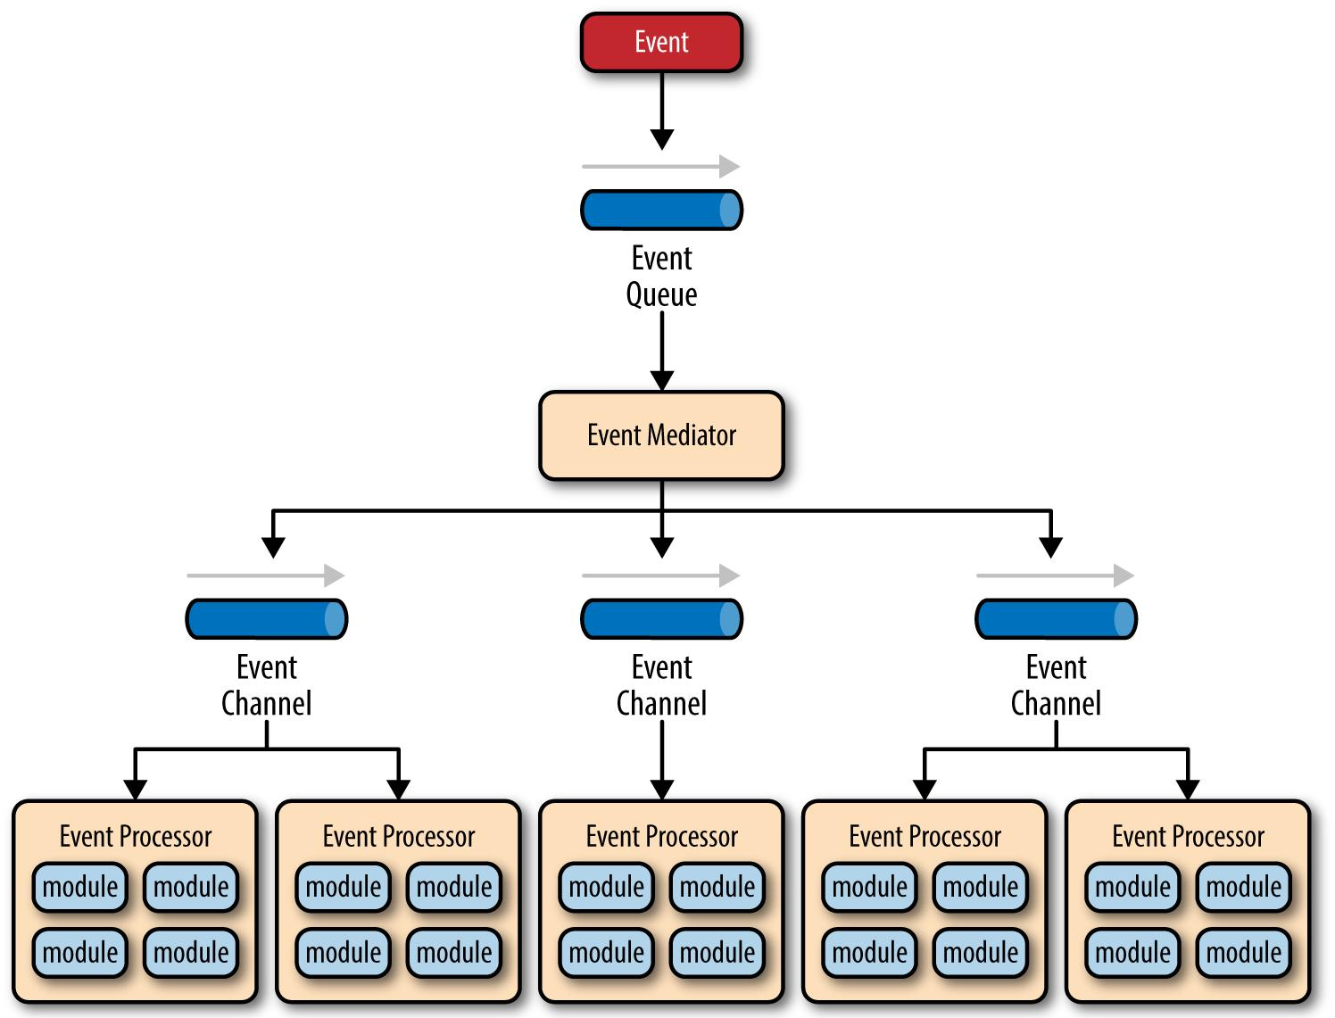
EDA - Mediator Topology
Notes:
Figure 2-1 illustrates the general mediator topology of the event-driven architecture pattern.
It is common to have anywhere from a dozen to several hundred event queues in an event-driven architecture.
The pattern does not specify the implementation of the event queue component;
it can be a message queue, a web service endpoint, or any combination
thereof.

Slide 7
Mediator Topology – Event Mediator
The event-mediator component is responsible for orchestrating the steps contained within the initial event
For each step in the initial event, the event mediator sends out a specific processing event to an event channel, which is then received and processed by the event processor
It is important to note that the event mediator doesn’t actually perform the business logic necessary to process the initial event; rather, it knows of the steps required to process the initial event

Slide 8
Mediator Topology – Event Processor
The event processor components contain the application business logic necessary to process the processing event
Event processors are self-contained, independent, highly decoupled architecture components that perform a specific task in the application or system
While the granularity of the event-processor component can vary from fine-grained (e.g., calculate sales tax on an order) to coarsegrained (e.g., process an insurance claim)
Each event-processor component should perform a single business task and not rely on other event processors to complete its specific task

Slide 9
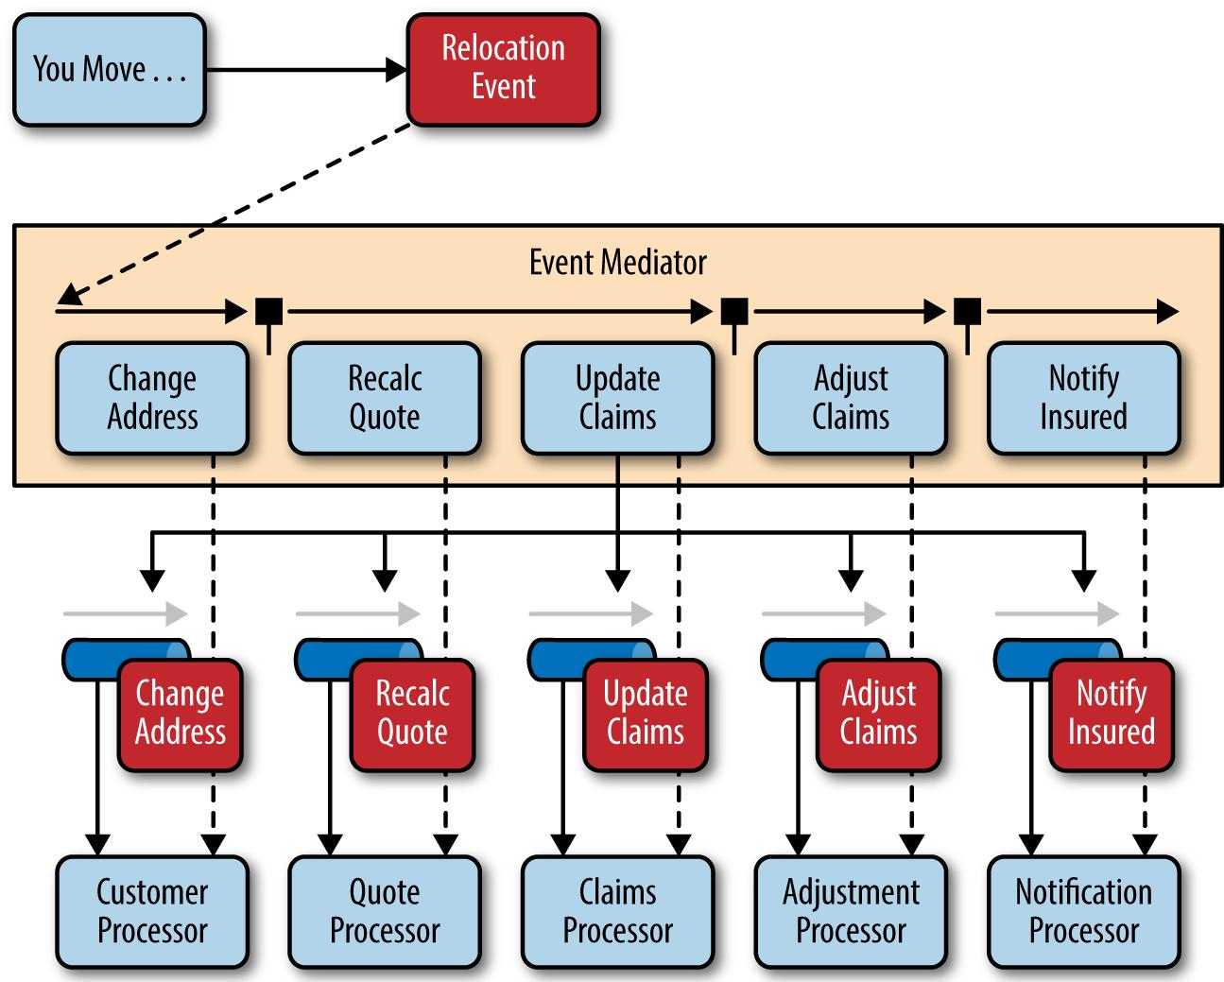
Mediator Topology - Example
Notes:
To illustrate how the mediator topology works, suppose you are insured through an insurance company and you decide to move.
In this case, the initial event might be called something like relocation event.
The steps involved in processing a relocation event are contained within the event mediator as shown in Figure 2-2.
For each initial event step, the event mediator creates a processing event (e.g., change address, recalc quote, etc.), sends that processing event to the
event channel and waits for the processing event to be processed by the corresponding event processor (e.g., customer process, quote
process, etc.).
This process continues until all of the steps in the initial event have been processed.
The single bar over the recalc quote and update claims steps in the event mediator indicates that these steps can be run at the same time.

Slide 10
Broker Topology
The broker topology differs from the mediator topology
there is no central event mediator
the message flow is distributed across the event processor components in a chain-like fashion through a lightweight message broker
This topology is useful when
you have a relatively simple event processing flow
you do not need central event orchestration

Slide 11
Broker Topology
There are two main types of architecture components within the broker topology:
A broker component: can be centralized or federated and contains all of the event channels that are used within the event flow
The event channels contained within the broker component can be message queues, message topics, or a combination of both
An event processor component: responsible for processing an event and publishing a new event indicating the action it just performed

Slide 12
Broker Topology
Each event-processor component is responsible for processing an event and publishing a new event indicating the action it just performed
Example: an event processor that balances a portfolio of stocks may receive an initial event called stock split
Based on that initial event, the event processor may do some portfolio rebalancing,
publish a new event to the broker called rebalance portfolio, which would then be picked up by a different event processor

Slide 13
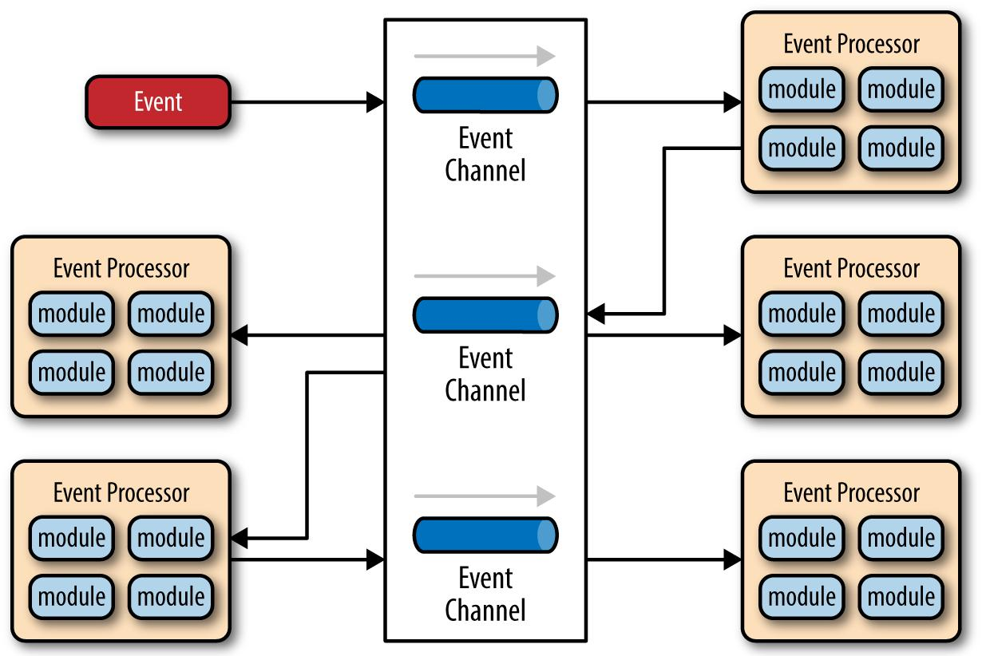
Broker Topology
Notes:
The best way to understand the broker topology is to think about it as a relay race.
In a relay race, runners hold a baton and run for a certain distance, then hand off the baton to the next runner, and so on down the
chain until the last runner crosses the finish line.
In relay races, once a runner hands off the baton, she is done with the race.
This is also true with the broker topology: once an event processor hands off the event, it is no longer involved with the processing of that specific
event.

Slide 14
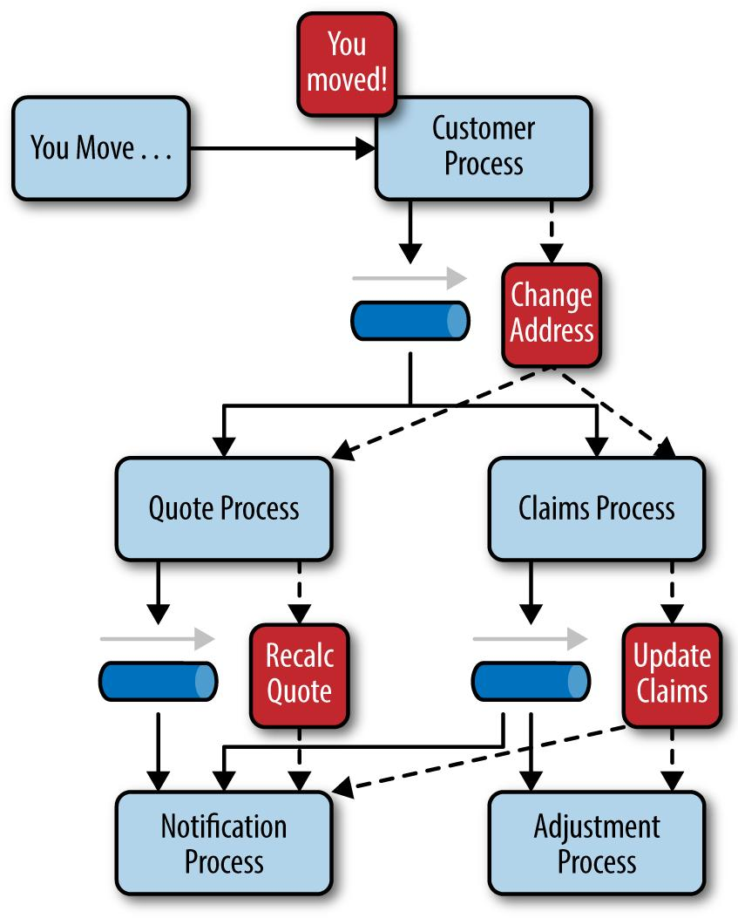
Broker Topology - Example
Notes:
To illustrate how the broker topology works, we’ll use the same example as in the mediator topology (an insured person moves).
Since there is no central event mediator to receive the initial event in the broker topology, the customer-process component receives the
event directly, changes the customer address, and sends out an event saying it changed a customer’s address (e.g., change address event).
In this example, there are two event processors that are interested in the change address event: the quote process and the claims process.
The quote processor component recalculates the new autoinsurance rates based on the address change and publishes an event
to the rest of the system indicating what it did (e.g., recalc quote event).
The claims processing component, on the other hand, receives the same change address event, but in this case, it updates an
outstanding insurance claim and publishes an event to the system as an update claim event.
These new events are then picked up by other event processor components, and the event chain continues through
the system until there are no more events are published for that particular initiating event.

Slide 15
EDA- Considerations
The event-driven architecture pattern is a relatively complex pattern to implement, primarily due to its asynchronous distributed nature
When implementing this pattern, you must address various distributed architecture issues,
remote process availability,
Lack of responsiveness,
broker reconnection logic in the event of a broker or mediator failure

